Slide 1
OSCE Questions
For JCM on 3 Dec 2014

Slide 2
Case 1
F/8 Good past health
She has fever with some URI symptoms for past few days. She starts to complain right leg pain for 2 days with a limping gait. No previous history of injury is noted.
Temp38.5 degree, stable vitals

Slide 3
Question 1
Name 4 possible diagnoses for her complaints (2marks)
Answers:
Septic Arthritis
Transient synovitis of hip
Leukemia
Perthes disease
NAI
SCFE ( not acceptable as it occurs in older age)

Slide 4
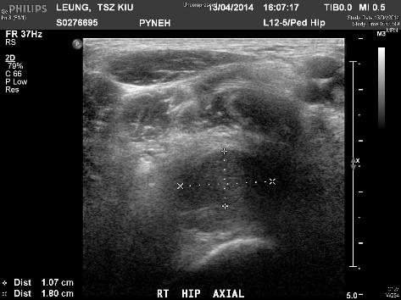
Right hip USG

Slide 5
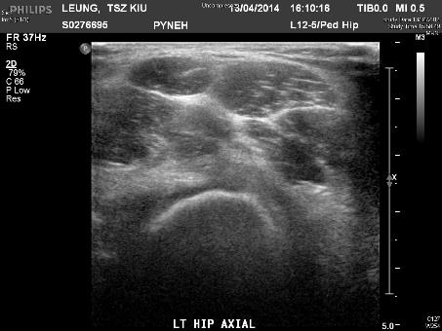
Left hip USG for comparison

Slide 6
Question 2
Give 2 sonographic findings for right hip scan (1mark)
Answer:
Distended anterior synovial space of right hip >5mm OR >2mm compared with the asymptomatic side
Presence of echogenicic effusion, likely pus

Slide 7
Question 3
What invasive diagnostic procedure would you consider for her to confirm your diagnosis? (1 mark)
Answer:
Ultrasound guided arthrocentesis

Slide 8
Question 4
Suggest 4 auxiliary laboratory tests you would order for her condition (2 marks)
Answers:
CBP with D/C
ESR
CRP
Blood culture

Slide 9
Final Diganosis
Septic Arthritis of right hip
USG Guided arthrocentesis drained 10 mL of pus
Blood C/ST and pus C/ST grew MSSA

Slide 10
Case 2
F/91
History of Old CVA on aspirin
She lost balance and fell backward, landed with occupit
All along GCS 15/15 and no focal sign
There is abrasion and hematoma over occpiut

Slide 11
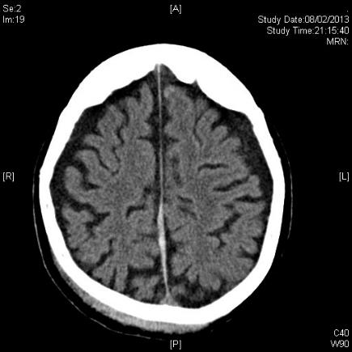
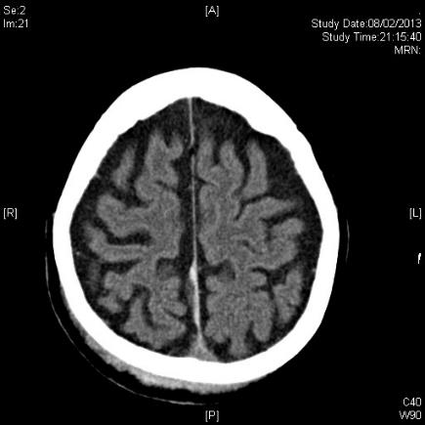
CT Brain

Slide 12
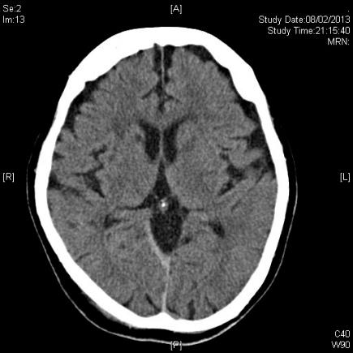
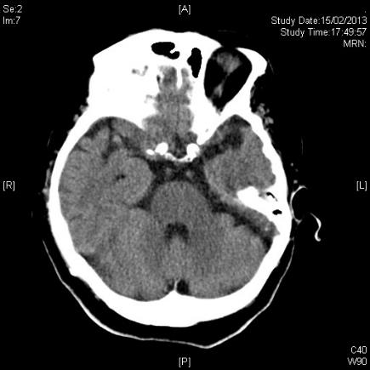
CT Brain

Slide 13
Question 1
Name 2 CT findings in this lady (2 marks)
Answers:
A Hyperdensity at right side of the interhemispheric fissure
OR
Acute Falx Subdural hemoatoma
Cerebral atrophy

Slide 14
Question 2
What are the possible clinical symptoms associated with this condition? (2 marks)
Answers:
Contralateral Monoparesis
Nonspecific Symptoms

Slide 15
Question 3
Name 2 risk factors for this condition (1 marks)
Answer:
Anticoagulants
Antiplatelet agents
Frontal or occipital constusion
Elderly

Slide 16
Case 3
M/52
Known BPH and hyperlipidemia
Chest pain 1.5 hrs with sweating before AED attendance by ambulance
GCS15/15, BP 120/87mmHg, P 68/min, SpO2 100% RA
Not in CHF

Slide 17
ECG
ECG

Slide 18
Question 1
Give 3 important ECG findings (1.5 marks)
Answers:
Upsloping STE at V2-4
STE lead I and aVL
STD lead II, III, aVF

Slide 19
Question 2
What is the cause for this condition and ECG features? (1 mark)
Answer
De Winter ST/T complex
A STEMI equivalent
Suggestive of pLAD occlusion

Slide 20
Question 3
If no contraindication, Suggest 2 oral medicines with proven mortality benefit you would give him? (1 mark)
Answer:
Aspirin
Plavix, Brillinta, or Effient

Slide 21
Question 4
Suggest one metabolic condition which can cause similar ECG pattern (0.5 mark)
Answer:
Tall T due to hyperkalemia

Slide 22
Question 5
What is the your treatment plan? (1 mark)
Answer:
Consult cardiac for primary PCI
Admit CCU for close monitoring

Slide 23
Case 4
M/44
Non-smoker
c/o gradual onset dyspnea, headache, sensation of face and throat swelling especially during supine position for 1 week
BP 124/76mmHg, P 94/min, SpO2 97% (RA)

Slide 26
Question 1
What is the diagnosis? (1 mark)
Answer:
Lung/ mediastinal mass
SVC syndrome

Slide 27
Question 2
Name 2 life-threatening conditions associated with the syndrome. (1 mark)
Answer:
Cerebral edema → confusion
Laryngeal edema → UAO

Slide 28
Question 3
Suggest 3 causes of the syndrome. (1.5 marks)
Answer:
Malignancy (CA lung, lymphoma)
Iatrogenic (e.g. catheter-related)
Mediastinal fibrosis/ vascular disease (vasculitis, extrinsic compression by aortic aneurysm)

Slide 29
Question 4
Suggest 1 further investigations for this patient to delineate the cause. (0.5 mark)
Answer:
Contrast CT thorax

Slide 30
Question 5
Suggest 2 treatments in this case. (1 mark)
Answer:
Urgent referral for RT
Endovascular stenting
Steroid

Slide 31
Case 5
M/56
History of alcoholic liver cirrhosis with portal hypertension
S/F with left chest wall contusion
BP 84/58mmHg, P 80/min

Slide 33
Question 1
Describe 3 abnormalities on the CT images (1.5 marks)
Answer:
Splenic laceration
Hemoperitoneum
Fracture left rib

Slide 34
Question 2
What is the most likely cause of hypotension in the patient? (0.5 mark)
Answer:
Hemorrhagic shock secondary to splenic injury

Slide 35
Question 3
What is the classification and the grading of this injury? (1 mark)
Answers:
AAST (American Association for the Surgery of Trauma)
Grade III

Slide 36
AAST Spleen Injury Grading

Slide 37
Question 4
Suggest 2 treatments if non-operative management is adopted for this patient (1 mark)
Answers:
Correction of underlying coagulopathy
Splenic artery embolization

Slide 38
Question 5
Suggest 2 indications of emergency laparotomy for this injury. (1 mark)
Answers:
Significant ongoing hemorrhage during observation
Presence of hemodynamic instability requiring exploration for additional intra-abdominal injury

